Slide 1
The Impacts of Microfinance: A Randomized Evaluation of Spandana’s program in Hyderabad
June 8, 2009
Abhijit Banerjee
Esther Duflo
Rachel Glennerster
Cynthia Kinnan

Slide 2
The Question
The most visible anti-poverty innovation in past 20 years
“There is mounting evidence that the availability of financial services for poor households - microfinance - can help achieve the MDGs.” – CGAP
“Evidence for”
reduction in poverty &hunger
universal primary education
promotion of gender equality & empowerment of women
reduction of child mortality
improvement in maternal health
“In twenty five years of academic and consulting work in local economic development, my experience has been that the microfinance programs often spell the death of the local economy.” Microfinance critic in FT

Slide 3
Why do we need an evaluation?
Microfinance supporters: people are borrowing and we are making money
Why do we need an evaluation?
No evaluation of apple-sellers. Why us?
Two answers:
Microfinance is often subsidized, example: India
Self-control problems: loans can be tempting → debt trap

Slide 4
Why do we need a randomized evaluation?
Cannot compare recipients with non recipients
MFIs target the poor
More enterprising (or more short-sighted) might self-select
Cannot compare recipients before and after
these are potentially enterprising people
Cannot compare trends for microfinance recipients and non-recipients
Morduch does this and finds a negative impact of Grameen Bank

Slide 5
What do we already know?
Much experimental work on how to make microfinance work better:
Group vs. individual liability (Giné and Karlan 2006)
Contract structure (Fischer 2008)
Repayment frequency (Field and Pande 2008)
Non-experimental evidence on the intensive margin impact of microfinance (Kaboski and Townsend 2008)
No randomized evaluations of the impact of microcredit
This study: answer some of the basic questions
business creation
durable goods purchase
consumption smoothing
etc.

Slide 6
Outline
Overview of Spandana program and survey
What was the take up of microcredit?
What impacts of microcredit should we expect?
Impact results
Average impact of the program
Different impacts for different groups?
The impact of borrowing
Conclusion

Slide 7
1. OVERVIEW
Traditional microcredit program
Group liability
Weekly or monthly repayment
Starting loan is Rs. 10,000 (~$250)
Interest rate changed over the period but was around 12% per year (nondeclining balance; ~24% APR)
A few individual-liability loans were also given
Spandana was already a large MFI in South India
Not previously operating in Hyderabad.
Agreed to randomly phase in operations in Hyderabad.

Slide 8
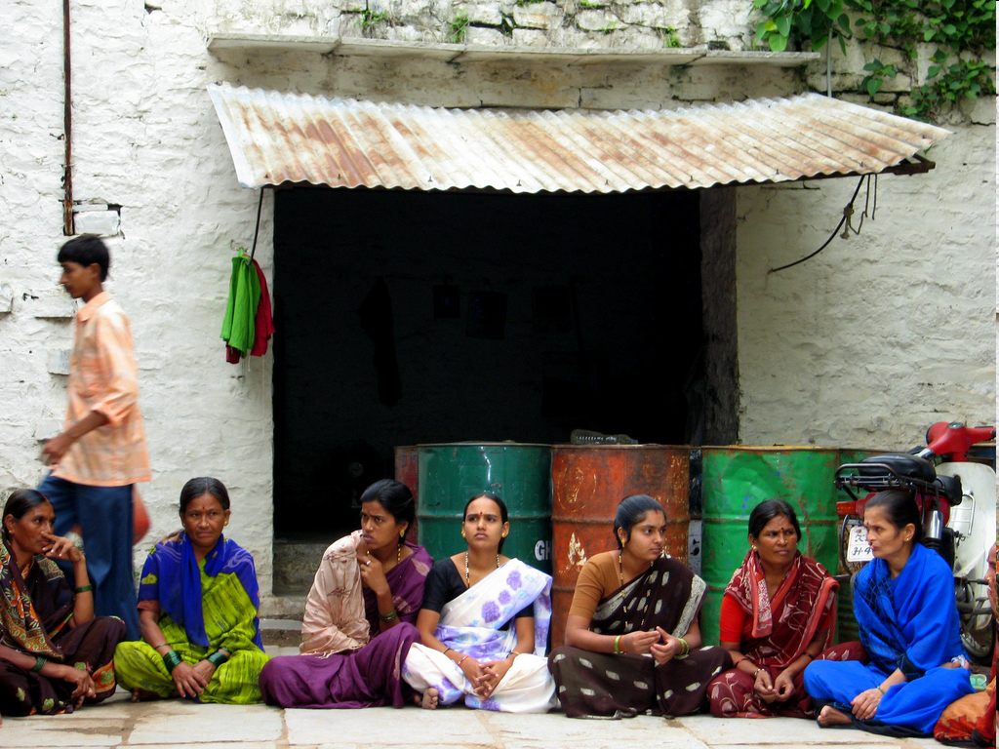

Slide 9
Data collection
Baseline survey: 2005
20 or 40 households per slum; 2,800 total
Intentionally did not do a panel (i.e. resurvey in the endline)
Census: 2006-7: sample frame for endline
Endline survey: 2007-8
15-24 months after loan disbursement started in a slum
Spandana borrowers were oversampled; we adjust for this in all results

Slide 10
Endline sample
104 slums: 52 treatment, 52 control
~7,200 households total
Households with the following characteristics were surveyed (more likely to become microfinance clients):
At least one woman aged 18-55
Household has lived in the slum at least 3 years
Not rated as someone Spandana wouldn’t lend to
Measures impact for households with these characteristics
results for other types of households could be different

Slide 11
Outcomes
Baseline and endline surveys:
Household debt
Consumption
Durable purchases
businesses
household
Business activities and profits
Decision-making (“empowerment”)
Education, health, etc.

Slide 12
Households at baseline
Family of 5
Monthly expenditure of ~Rs 5,000 (~$125)
98% of 7-11 year olds, 84% of 12-15 year olds in school
Borrowing (from friends, moneylenders, etc.) is common (69% of households); average interest rate 3.85% per month
Almost no MFI borrowing.

Slide 13
Entrepreneurship at baseline
31% of the households run at least one small business (vs. OECD average of 12%)
Of these, 9% of households run more than one business
But these businesses had few…
Specialized skills (mostly general stores, tailors, fruit/vegetable vendors)
Employees:
Only 10% have any employees; none has more than 3
Assets
20% use no productive assets whatsoever.
Scale of businesses:
Sales: Rs 13,000 (~$325) per month
Profits: Rs 3,040 (~$75) per month

Slide 14
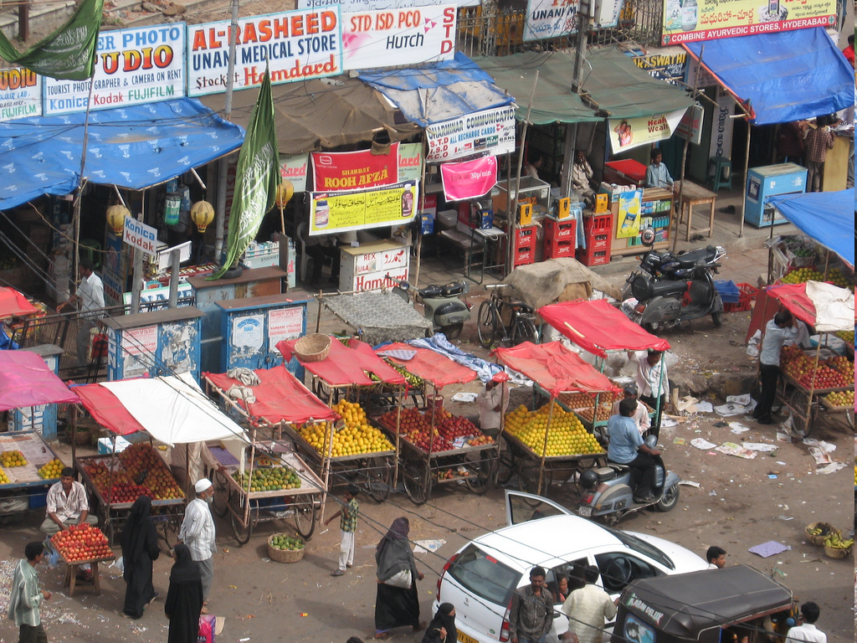
Millions of Entrepreneurs…

Slide 15
Treatment-Control Balance: Slum Level
treatment
control
No differences are statistically significantly different

Slide 16
Treatment-Control Balance: Households
No differences are statistically significantly different
treatment control

Slide 17
Why do you want a loan?

Slide 18
(Control) households at endline
The average household is a family of 6 (4.7 adu)
Monthly expenditure of Rs 6,375 (~$160)
96% of the 7-11 year olds, and 85% of the 12-15 year olds in school
Borrowing is very common (89% of households)
average interest rate ~2% per month
18.7% have an MFI loan

Slide 19
What should we expect
Assume:
fixed cost of starting a business
variable cost of running it
When credit access increases:
Those without an existing business decide
Some will start a business (richer, lower opportunity cost, those with better ideas)
Starting a business might involve cutting consumption
The rest will just finance consumption
Existing business owners don’t face a fixed cost: borrow to increase consumption and variable capital
Their profits should go up
Overall consumption may go up or down

Slide 20
2. TAKE UP?

Slide 21
Impact on borrowing
8.3 percentage points more MFI borrowers (Spandana or other) in treatment slums
13.3 percentage points more Spandana borrowers
Average of Rs. 1,260 of additional MFI borrowing per household in treatment slums (ITT estimate)
These relatively low rates of MFI loan takeup are similar to those found in other J-PAL projects.

Slide 22
Businesses got started

Slide 23
Impact on expenditure
*
*
*

Slide 24
Child welfare and women’s “empowerment”

Slide 25
Predicting who is a likely entrepreneur
*

Slide 26
Expenditure of groups, by business status
Table 5: Expenditure for control households, by business status
 |  | Did not have a business 1 yr ago
 | Old business owners | High-business propensity | Low-business propensity |  | P value: (1)=(3) | P value: (2)=(3)
 | (1) | (2) | (3)
Total PCE (Rs/mo) | 1,479.56 | 1,430.31 | 1,347.56 |  | 0.014 | 0.011
Nondurable PCE (Rs/mo) | 1,335.57 | 1,336.81 | 1,237.32 |  | 0.006 | 0.051
Number of control HHs | 979 | 2,571 | 1,525
Note: P-values computed using cluster-robust standard errors. Old business owners are those who own a business started at least 1 year before the survey. High-business propensity households are those (who did not have a business 1 year before the survey)

Slide 27
Borrow from any MFI?
*
**

Slide 28
Start a new business
**

Slide 29
Durable expenditure
**
**

Slide 30
Non durable expenditure
**
**

Slide 31
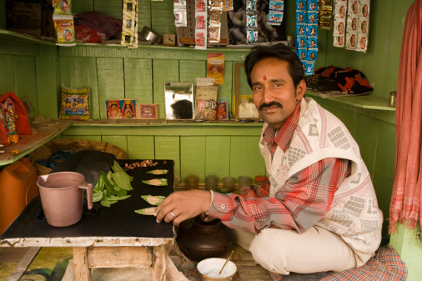
Temptation

Slide 32
Temptation goods
**
**

Slide 33
Results by business status
Old business owners borrow at (relatively) high rates and invest in durable goods
Among those who didn’t have a business 1 year ago:
Those with high propensity (literate, non-wage-working spouse) borrow and reduce nondurable consumption
Those with low propensity (illiterate and/or wage-working spouse) borrow and increase nondurable consumption

Slide 34
The impact of borrowing (TOT)
If there are no GE/spillover effects of Spandana’s expansion, treatment is a valid instrument for borrowing from Spandana.
IV effects will be an
over-estimate if the presence of Spandana also induced some who did not take a loan to start or expand a business (for example, due to social learning)
under-estimate if the presence of Spandana discouraged some who did not take a loan to start or expand a business (for example, due to competition)

Slide 35
Impacts of borrowing on borrowers

Slide 36
Conclusions
Takeup of MFI loans is lower than is often predicted
This matters for planning sample sizes
It also suggests microcredit is not for everyone
Microcredit does have impacts, and they differ for different households:
1 in 8 new borrowers start a new business
Those who already had businesses invest in durables and restrict their “temptation” consumption; their profits go up
Others consume more
Microcredit may neither be the life changing experience that some have described, nor the new usury: the bottom line is that not everyone may want to become an entrepreneur.

